Slide 1
Trees and Binary Search Trees

Slide 2
Outline
Trees
Binary Search Trees
Object-Oriented Programming
2

Slide 3
Trees
A Tree in Data Structures is a hierarchical data structure used for storing data.
They use root as the top element and Leaf as the last element
Root is also called a parent if it has some more nodes connected to it
Divide-and-Conquer
3

Slide 4
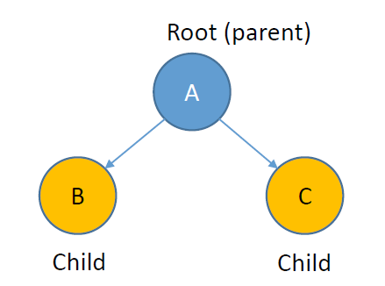
Trees
4

Slide 5
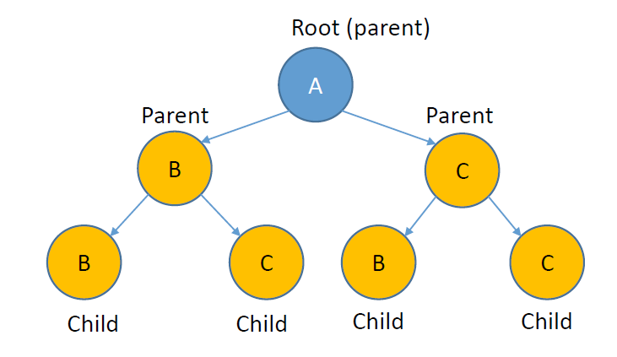
Trees
5

Slide 6
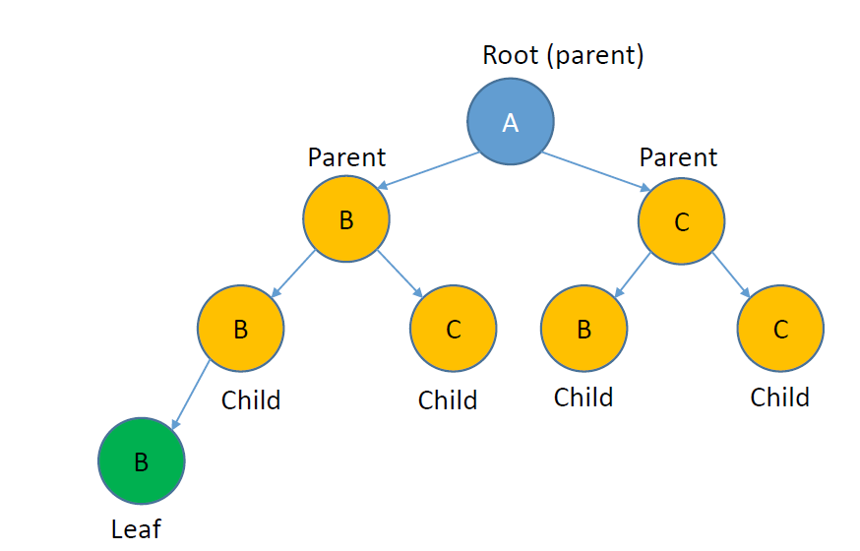
Trees
6

Slide 7
Binary Trees
A Tree in which a node has maximum of 2 nodes.
It can still have 1 child or a node.
7

Slide 8
Binary Trees
8

Slide 9
Binary Search Tree
A Binary Tree is called a Binary Search Tree if
Left side values are lesser than the parent
Right side values are greater than the parent
9

Slide 10
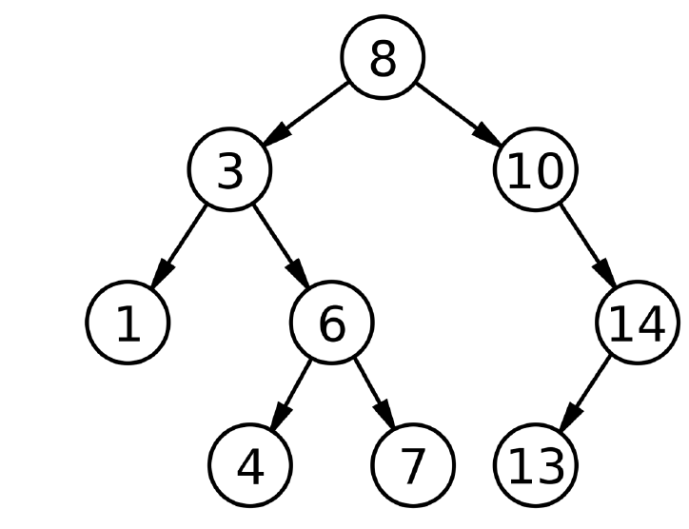
Binary Search Tree
10

Slide 11
Binary Search Tree
Draw a Binary Search Tree for the following numbers
5 10 2 11 1 3 20 15 100
11

Slide 12
Binary Search Tree
Draw a Binary Search Tree for the following numbers
5 10 2 11 1 3 20 15 90
5
2
10
1
3
11
20
15
90
12

Slide 13
Programming Binary Search Tree
5 10 2 11 1 3 20 15 90
left
100
right
root = null
null | 5 | null
Node

Slide 14
Programming Binary Search Tree
5 10 2 11 1 3 20 15 90
left
Root = 100
right
null | 5 | null
Node

Slide 15
Programming Binary Search Tree
5 10 2 11 1 3 20 15 90
left
Root = 100
right
null | 5 | null
Node
parent
current

Slide 16
Programming Binary Search Tree
5 10 2 11 1 3 20 15 90
left
Root = 100
right
200
null | 5 | null
null | 10 | null
Node
parent
current

Slide 17
Programming Binary Search Tree
5 10 2 11 1 3 20 15 90
left
Root = 100
right
200
null | 5 | null
null | 10 | null
Node
parent
current

Slide 18
Programming Binary Search Tree
5 10 2 11 1 3 20 15 90
left
Root = 100
right
null | 5 | 200
parent
current
200
null | 10 | null
Node

Slide 19
Programming Binary Search Tree
5 10 2 11 1 3 20 15 90
left
Root = 100
right
300
null | 5 | 200
null | 2 | null
Node
parent
current
200
null | 10 | null
Node

Slide 20
Programming Binary Search Tree
5 10 2 11 1 3 20 15 90
left
Root = 100
right
300
null | 5 | 200
null | 2 | null
Node
parent
current
200
null | 10 | null
Node

Slide 21
Programming Binary Search Tree
5 10 2 11 1 3 20 15 90
left
Root = 100
right
300 | 5 | 200
300
parent
current
200
null | 2 | null
Node
null | 10 | null
Node

Slide 22
Programming Binary Search Tree
5 10 2 11 1 3 20 15 90
left
Root = 100
right
400
300 | 5 | 200
null | 11 | null
Node
300
parent
current
200
null | 2 | null
Node
null | 10 | null
Node

Slide 23
Programming Binary Search Tree
5 10 2 11 1 3 20 15 90
left
Root = 100
right
400
300 | 5 | 200
null | 11 | null
Node
300
parent
current
200
null | 2 | null
Node
null | 10 | null
Node

Slide 24
Programming Binary Search Tree
5 10 2 11 1 3 20 15 90
left
Root = 100
right
400
300 | 5 | 200
null | 11 | null
Node
300
parent
200
null | 2 | null
Node
null | 10 | null
Node
current

Slide 25
Programming Binary Search Tree
5 10 2 11 1 3 20 15 90
left
Root = 100
right
400
300 | 5 | 200
null | 11 | null
Node
300
200
null | 2 | null
Node
null | 10 | null
Node
parent
current

Slide 26
Programming Binary Search Tree
5 10 2 11 1 3 20 15 90
left
Root = 100
right
400
300 | 5 | 200
null | 11 | null
Node
300
200
null | 2 | null
Node
null | 10 | null
Node
parent
current

Slide 27
Programming Binary Search Tree
5 10 2 11 1 3 20 15 90
left
Root = 100
right
300 | 5 | 200
300
200
null | 2 | null
Node
null | 10 | 400
Node
parent
current
400
null | 11 | null
Node

Slide 28
Printing Binary Search Tree
5
2
10
1
3
11
20
15
90

Slide 29
Printing Binary Search Tree
root
current
5
2
10
1
3
11
20
15
90
Stack

Slide 30
Printing Binary Search Tree
root
current != null
current
5
5
2
10
1
3
11
20
15
90
Stack

Slide 31
Printing Binary Search Tree
root
current != null
5
5
2
10
current
1
3
11
20
15
90
Stack

Slide 32
Printing Binary Search Tree
root
current != null
5
2
5
2
10
current
1
3
11
20
15
90
Stack

Slide 33
Printing Binary Search Tree
root
current != null
5
2
5
2
10
1
3
11
current
20
15
90
Stack

Slide 34
Printing Binary Search Tree
root
current != null
!stack.empty()
5
1
2
5
2
10
1
3
11
20
current
null
15
90
Stack

Slide 35
Printing Binary Search Tree
root
current != null
!stack.empty()
5
2
5
2
10
1
3
11
20
current
null
15
90
Stack
1

Slide 36
Printing Binary Search Tree
root
current != null
!stack.empty()
5
5
2
10
1
3
11
current
20
15
90
Stack
1 2

Slide 37
Printing Binary Search Tree
root
current != null
!stack.empty()
5
3
5
2
10
1
3
11
current
20
15
90
Stack
1 2

Slide 38
Printing Binary Search Tree
root
current != null
!stack.empty()
5
3
5
2
10
1
3
11
20
current
null
15
90
Stack
1 2

Slide 39
Printing Binary Search Tree
root
current != null
!stack.empty()
5
5
2
10
1
3
11
20
current
null
15
90
Stack
1 2 3

Slide 40
Printing Binary Search Tree
root
current != null
!stack.empty()
5
5
2
10
1
3
11
20
current
null
15
90
Stack
1 2 3

Slide 41
Printing Binary Search Tree
root
current != null
!stack.empty()
current
5
2
10
1
3
11
20
15
90
Stack
1 2 3 5

Slide 42
Printing Binary Search Tree
root
current != null
!stack.empty()
5
2
10
current
1
3
11
20
15
90
Stack
1 2 3 5

Slide 43
Wrap-up
Trees
Binary Search Trees
Object-Oriented Programming
43

